Slide 1
THE OFFICE OF STUDENT ACCOUNTS
WELCOME TO TCNJ!
Notes:
Are your classroom colors different than what you see in this template? That’s OK! Click on Design -> Variants (the down arrow) -> Pick the color scheme that works for you!
Feel free to change any “You will…” and “I will…” statements to ensure they align with your classroom procedures and rules!

Slide 2
Today’s Discussion
Authorized User
Cost of Attendance
Bill Dates
Viewing the Bill / Payment Methods
Authorized Payer
Parking
Additional Information

Slide 3


Authorized User Access
By law, TCNJ can only communicate billing and payment information to the registered TCNJ student.
Student’s can grant permission for their parent(s) or guardian(s) to have access to their account and the ability to communicate with college officials through our Authorized User feature.
We operate in accordance to the Family Educational Rights and Privacy Act (FERPA) from 1974
For more information on FERPA, please visit: http://recreg.tcnj.edu/student-privacy-rights/#what
For more information on TCNJ’s Authorized User feature, please visit: http://authorizeduser.tcnj.edu/

Slide 4
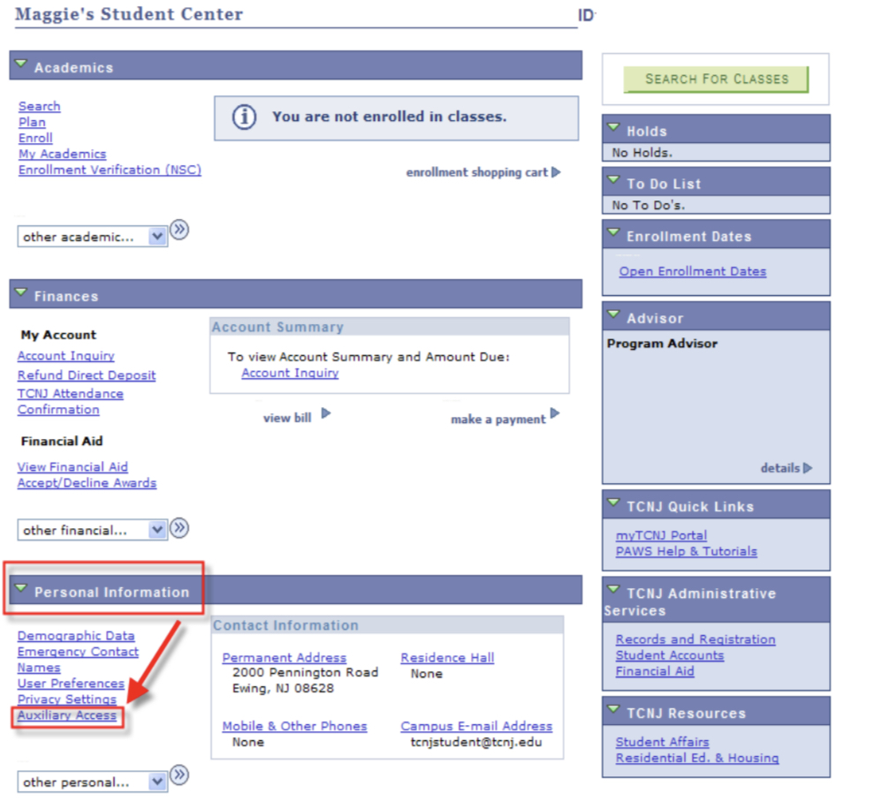
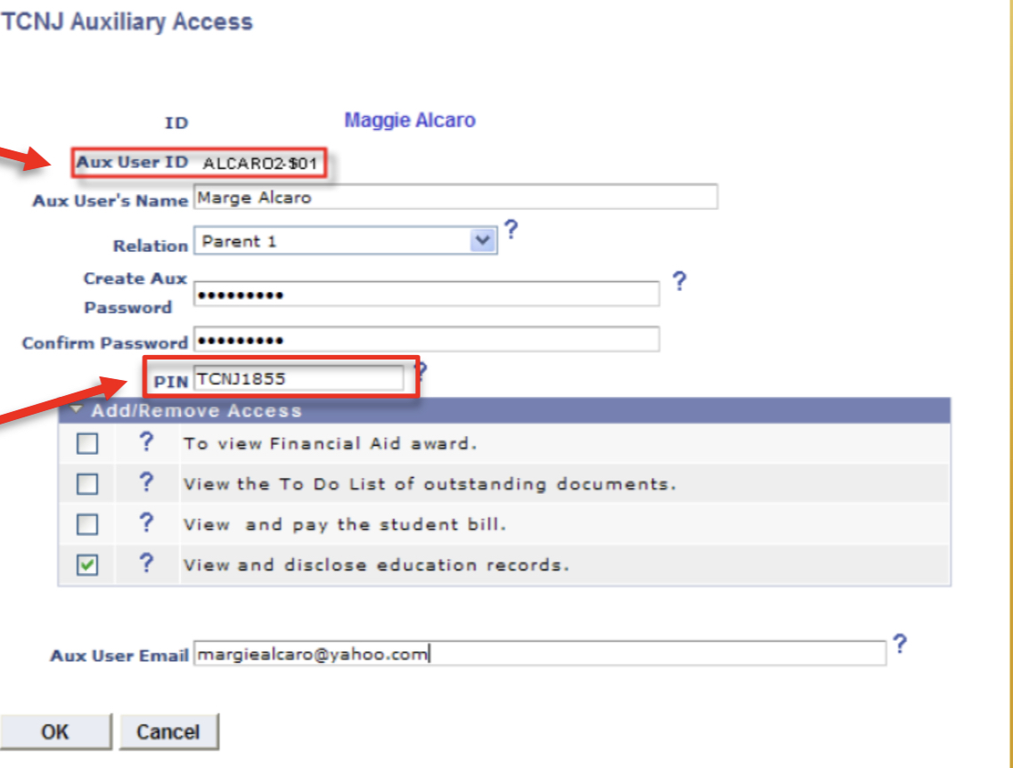
SIGNING UP AN AUTHORIZED USER

Slide 5
2023-2024 Undergrad Direct Cost
In-State | Fall ‘23 | Spring ‘24 | Year
Tuition | $ 7,353.00 | $ 7,353.00 | $ 14,706.00
Fees * | $ 1,999.50 | $ 1,999.50 | $ 3,999.00
Room & Board ** | $ 7,665.96 | $ 7,665.96 | $ 15,331.92
Total | $17,018.46 | $17,018.46 | $ 34,036.92
Out-of-State | Fall ’23 | Spring ‘24 | Year
Tuition | $ 10,294.50 | $ 10,294.50 | $ 19,796.24
Fees * | $ 1,999.50 | $ 1,999.50 | $ 3,999.00
Room & Board ** | $ 7,665.96 | $ 7,665.96 | $ 15,331.92
Total | $ 19,959.96 | $ 19,959.96 | $ 39,919.92
* Student Health Insurance - $2,611 for 2023-2024. The fall fees will increase by this amount if a
waiver is not submitted and approved.
** Cost of room and an average meal plan. Cost differs based on meal plan selected.

Slide 6
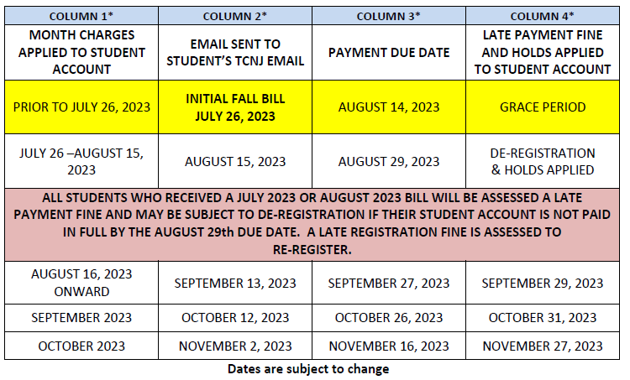
Bill Due Dates
ACADEMIC YEAR 2023 - 2024 BILLING CALENDAR
Students are responsible for checking PAWS on a regular basis as it is possible for changes to occur between billing cycles.
Online: https://studentaccounts.tcnj.edu/billing/billing-calendar/
An official TCNJ email will be sent to students advising them to check their student account in PAWS to view their bill. All billing notifications are done electronically via e-mail.
Students are responsible for notifying the responsible bill payer and/or signing up the responsible bill payer to receive e-mail billing notifications.

Slide 7
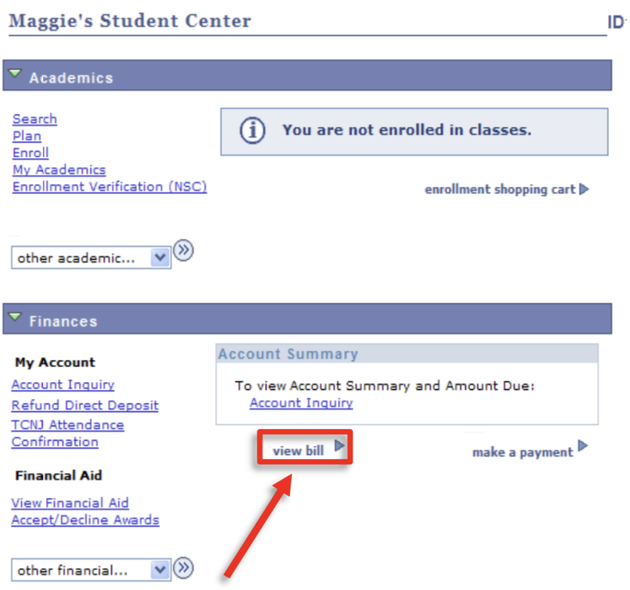
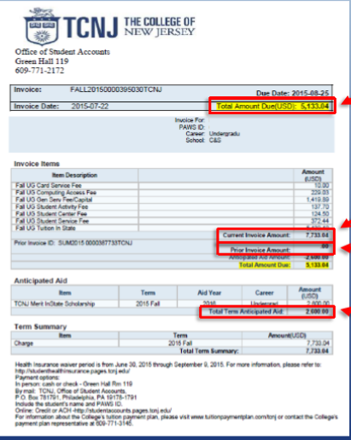
How to View Your Bill

Slide 8
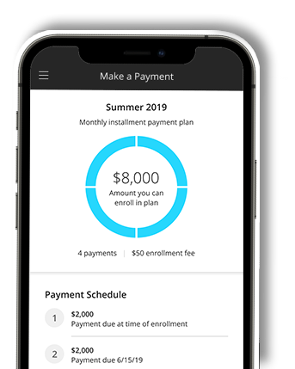

Authorized Payer – Online Payments
Students:
Looking for a parent/guardian/ grandparent to assist with paying your semester tuition bill online.
It is your responsibility to invite them via our Transact payment gateway to become Authorized Payers
Visit our Authorized User website for more details: https://studentaccounts.tcnj.edu/authorized-payer-for-online-payments/
Parents / Guardians / Grandparents:
Once you receive the invitation from your student, you will create a log-in that will be used to authenticate you to make a payment.
Provides a more secure and robust payment experience for the payer.

Slide 9




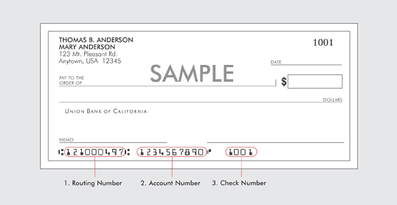
Online Payment Methods
Credit Card | E-Check
Credit card payment are only accepted electronically via our student system (PAWS) TCNJ accepts Our credit card processor currently charges a 2.85% convenience/service fee. International payments charged 4.25% convenience/service fee. Our third party vendor retains the convenience fee | The funds can be debited from a U.S. checking or savings bank account in U.S. dollars. Please be sure to have your routing and checking account number readily available to complete this transaction. ***Checks drawn off of line of credit accounts (money market checks or home equity checks) are not accepted.***

Slide 10


Additional Online Payment Methods
529 College Plan | International Payment
Coming Soon – July 19th Online electronic transfer process for a 529 payment from the college plan provider to the college on behalf of the student Processing fees may apply. | Coming Soon – July 19th Transfer of funds using our third party provider, Transact, to assist with the wire process. There may be fees associated with a wire transfer payment

Slide 11



Payment in Person & By Mail
You may pay with
- Cash (in-person only with photo ID)
- Check
- Money order
Payment by check, 529 college plan, or money order may be sent to our bank’s lock box :
The College of New Jersey Lockbox
P. O. Box 23763
New York, NY 10087-3763
PLEASE do not send scholarship checks to the lock box.
The student’s name and TCNJ PAWS ID number must appear on the check.

Slide 12

Private Scholarships
Please do not send scholarship checks to our New York lockbox address.
Checks should be send directly to TCNJ at the address below for reporting and posting into our student system (PAWS) on behalf of the student.
The College of New Jersey
Office of Student Accounts
P. O. Box 7718
Ewing, NJ 08628-0718

Slide 13
Tuition Payment Plan
Semester Plan – Fall and Spring
6 Months each semester / 6 Payments
Covers just the semester bill, enrollment fee of $25 per semester
Fall semester - July 25th to December 25th
Spring semester - January 25th to June 25th
Enrollment begins July 18th for the Fall semester and November for the Spring semester
Enrollment deadline for Fall: Early September , Spring: Early February
Payments due on the 25th of each month
No credit check or co-signer needed; this is NOT a loan

Slide 14

Student Injury and Sickness Insurance Plan (SISIP)
Annual Undergraduate Cost $2,611
Billed only in the fall semester

Slide 15

Tuition Insurance Plan
Optional Tuition Refund Insurance, through GradGuard, covers the cost of tuition and related fees should a student have to withdraw or take a leave of absence from the College for unexpected health-related reasons.
Cost based on amount of coverage desired.
Fall Withdrawal Cycle | TCNJ Refund | Insurance Pays | Total Refund
Aug 29 - Sept 6 | 100% | 0% | 100%
Sept 7 - Sept 19 | 75% | 25% | 100%
Sept 20 - Oct 3 | 50% | 50% | 100%
After Oct 3rd | 0% | 100% | 100%
Enrollment into the Tuition Refund Insurance policy must be completed by the first day of the Fall 2023 semester
Visit:
https://studentaccounts.tcnj.edu/insurance/tuition-refund-insurance/
Notes:
Pending costs per decision of board of trustees

Slide 16


Parking
Commuters
Parents
Freshmen Residents
May have a vehicle on campus with a valid decal
Decals are ordered through CARS, our web-based parking system in early August. In-person requests are not accepted
Must obtain a Visitor’s pass from the Information Booth in front of Trenton Hall or Campus Police
Are NOT eligible to have
a car on campus,
however certain
exceptions may be
granted. Visit
https://parking.tcnj.edu/
May purchase up to two weekly passes to park on campus each semester

Slide 17
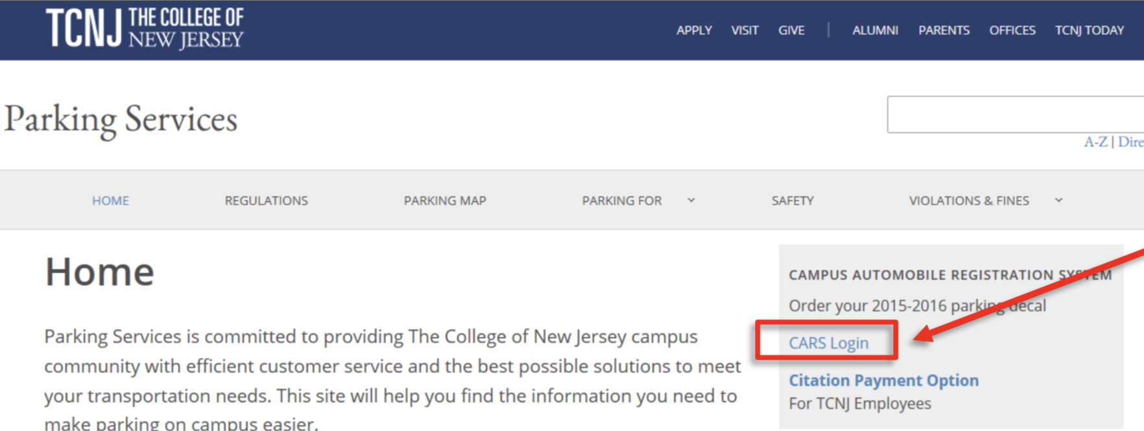
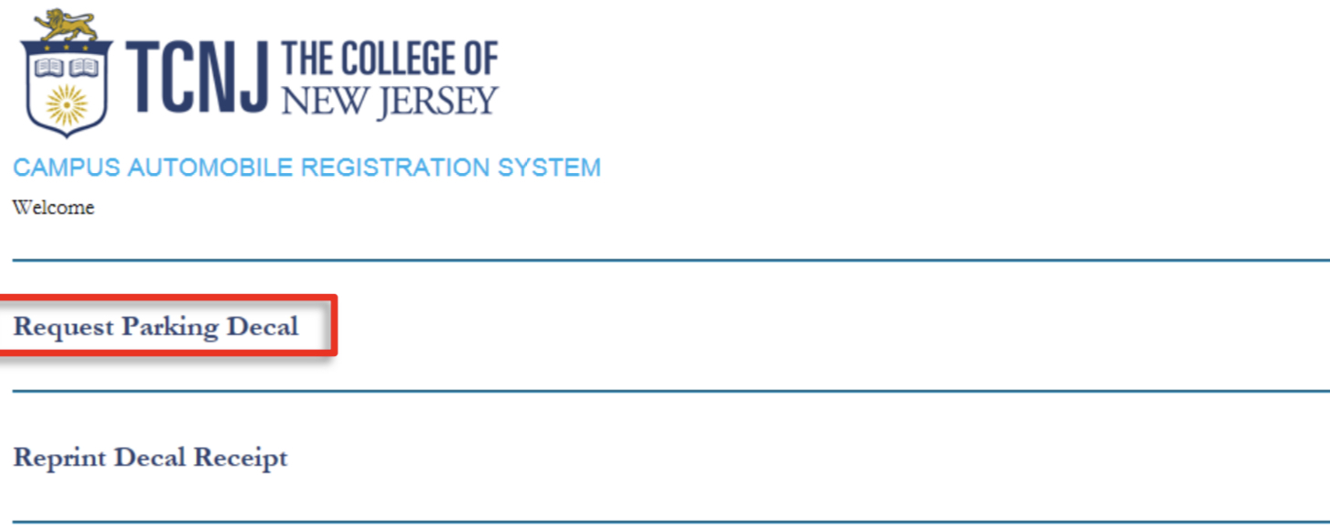
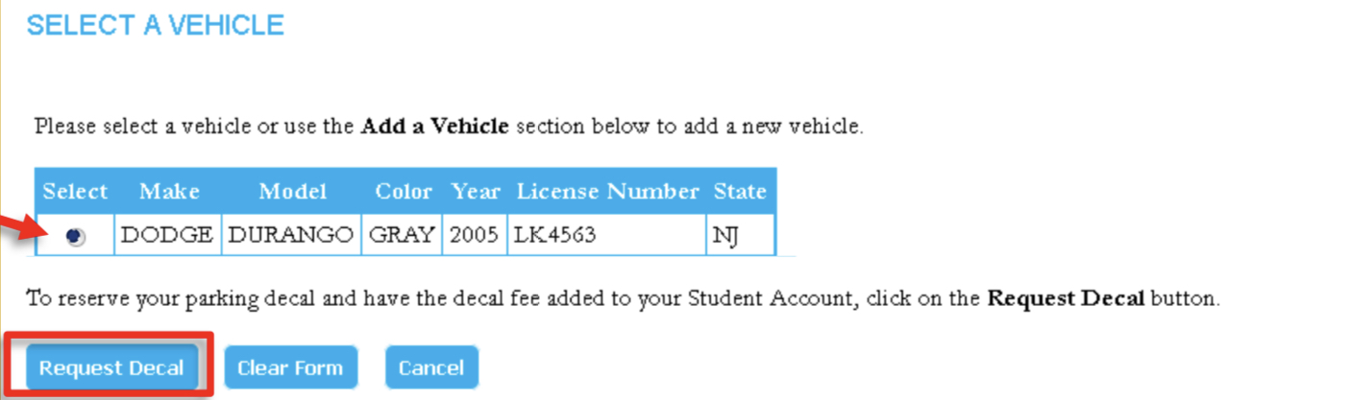


HOW TO REGISTER A CAR

Slide 18
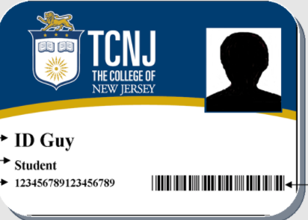
TCNJ Student ID Card
Your TCNJ student ID is used for:
Entrance to campus buildings, fitness facilities, and labs
Photo
identification
Library
services
Get-It wallet
Admittance to campus events
Access to your meal plan in the Eickhoff Dining Hall
If lost/stolen, a new TCNJ ID can be obtained from the Office of Student Accounts in Green Hall 119 for a fee

Slide 19
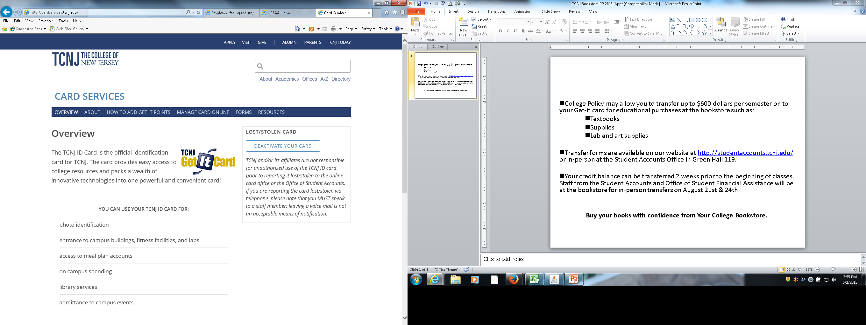
Need Money for Books / Supplies – Excess Financial Aid or Overpayment ??
College policy may allow you to transfer up to $600 per semester onto your Get-it Card for educational purchases at the bookstore such as:
    Textbooks
    Supplies
Get-it Card transfer forms are available on the Student Accounts website at http://studentaccounts.tcnj.edu/ or in Green Hall 119.
Your credit balance can be transferred 2 weeks prior to the beginning of classes.

Slide 20
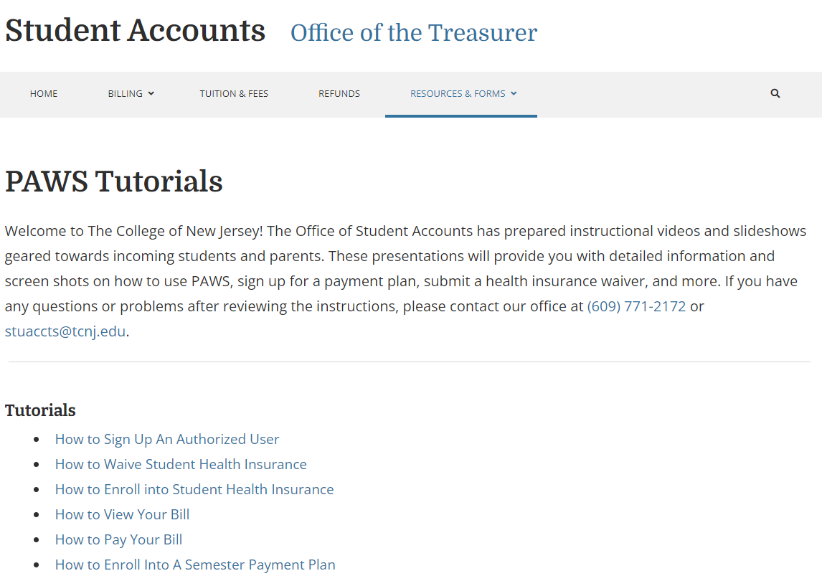
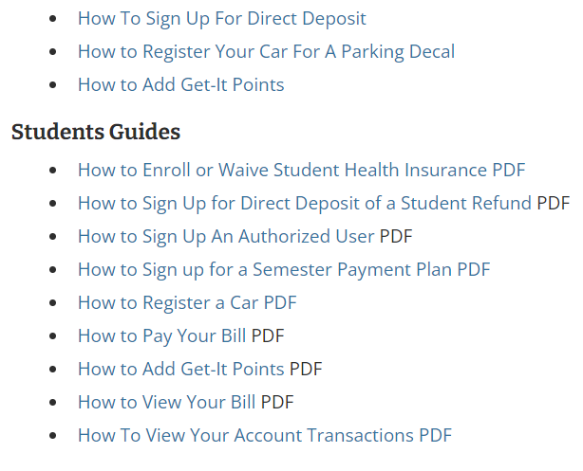
For Your Assistance – Student Account Tutorials

Slide 21


The Office of Student Accounts
Green Hall-Room 119
Academic Year Office Hours:
Monday - Friday 8:30am to 4:30pm
Summer Office Hours:
July 10th - August 11th
Monday-Thursday 8:00am- 4:30pm
College offices are closed Fridays in the summer
(July 14th, 21st, 28th, August 4^{th ,} 11th)
Contact Information:
Phone: 609.771.2172 Fax: 609.637.5111
Email: stuaccts@tcnj.edu – preferred method

